Slide 1
Paradox Lake Association
State of the Lake Meeting
May 2021

Slide 2
Welcome from the PLA Board
President – Mary Randall
Vice President – Dan Gorke
Upper Lake Directors – Nancy Girling, Micki Kuttler, Bob Hauserman
Lower Lake Directors – Pete Pelone, Doug Kaufman, Tony Petrongolo
Treasurer – Matt Massiano
Recording Secretary – Dee Dee Foran

Slide 3
Agenda
Welcome
Summary / Closing Thoughts
Finances – Matt Massiano
Membership – Dan Gorke
Invasive Efforts – Nancy Girling
2021 Elections- Pete Pelone
Volunteer Opportunities – Dee Dee Foran
Communications – Micki Kuttler

Slide 4
Mission Our collective purpose is to preserve and protect Paradox Lake and its surroundings, to enhance the water quality, fishery, boating safety, and aesthetic values of Paradox Lake, as a public recreational facility for today and for future generations.

Slide 5
State of the Lake 2020 in Review
2020 unfolded as a year of uncertainty, but turned positive for PLA
Increase in membership, contributions, fund raising, and number of member volunteers
Allowed us to increase the number of days of harvesting
2020 was a good year for PLA

Slide 6
State of the Lake 2020 In Review
Water Quality – assessed by DEC, rated AA(T), good for drinking, swimming, trout survival
Continue to support the fight against Aquatic Invasive Species entering our lake
Rte 74 Boat Wash Station cleaned 152 watercraft, down from 190 in 2019
Failed Inspections – 0%
Paradox Campground Boat Launch inspected 1050 watercraft, up from 969 2019
47% Boats, 38% Kayak, 9% Canoe, 3% PWC, 3% Other
Failed Inspections- 0%
91% were aware of AIS spread prevention
Strong year for addressing invasives already in our lake with 21 days of harvesting by Aqualogic
12.5 days in Eastern basin, 4.5 days in Narrows; 3 days Grass Island; Knox Beach & Glen Ray/Caldwell Bays .5 each
Aqualogic harvested 910 gallons EWM; PLA volunteers harvested 3,528 EWM plants, 50 Curlyleaf Pondweed!

Slide 7
State of the Lake 2021
Boat Launch and Rte 74 Boat Wash Station to open Memorial Day Weekend
Boat wash open seven days
Boat Launch Station coverage reduced to Thursday – Monday based on historical activity and funding
Signage being installed at launch to promote awareness and compliance
DEC annual stocking program for Paradox Lake: 5,300 Rainbow Trout, 8.5 – 9.5 inches, 500 Landlocked Salmon 6 – 7 inches, 1,500 Lake Trout 6 – 7 inches.
PLA in-person events are currently on hold, but board is evaluating changes

Slide 8
State of the Lake 2021
Funding to support our initiatives is top of mind
A balanced budget has been adopted for 2021, but member contributions and successful fundraising will be critical
A Grants Committee is investigating opportunities, and will work with SLA, ESSLA, Town of Schroon, and watershed partners
In 2020, PLA Board engaged in long term planning process to ensure we have a good picture of where key influencing factors are headed.
Benchmarked with other lakes
Spoke with key groups (APIPP, AWI, ALA)
Identified four key objectives for 2020-21
Notes:
Conducted a long range planning exercise
Ensure we have a good picture of where key influencing factors are headed
Increases confidence that the PLA actions are correct and robust
The 2020 Actions are aligned with the PLA objectives
Optimize mitigation efforts used to address aquatic invasives
Increase awareness and engagement of our lake community and visitors
Identify funding opportunities to support our purpose
Identify funding to ensure the long term sustainability of preserving and protecting our lake
Realistic assessment given resource levels and potential Covid 19 impacts

Slide 9
State of the Lake 2020 – 21 Objectives
Optimize mitigation efforts used to address aquatic invasives
Increase awareness and engagement of our lake community and visitors
Identify funding opportunities to support our purpose
Identify funding to ensure the long-term sustainability of preserving and protecting our lake
Notes:
Conducted a long range planning exercise
Ensure we have a good picture of where key influencing factors are headed
Increases confidence that the PLA actions are correct and robust
The 2020 Actions are aligned with the PLA objectives
Optimize mitigation efforts used to address aquatic invasives
Increase awareness and engagement of our lake community and visitors
Identify funding opportunities to support our purpose
Identify funding to ensure the long term sustainability of preserving and protecting our lake
Realistic assessment given resource levels and potential Covid 19 impacts

Slide 10
Invasives Efforts
Nancy Girling

Slide 11
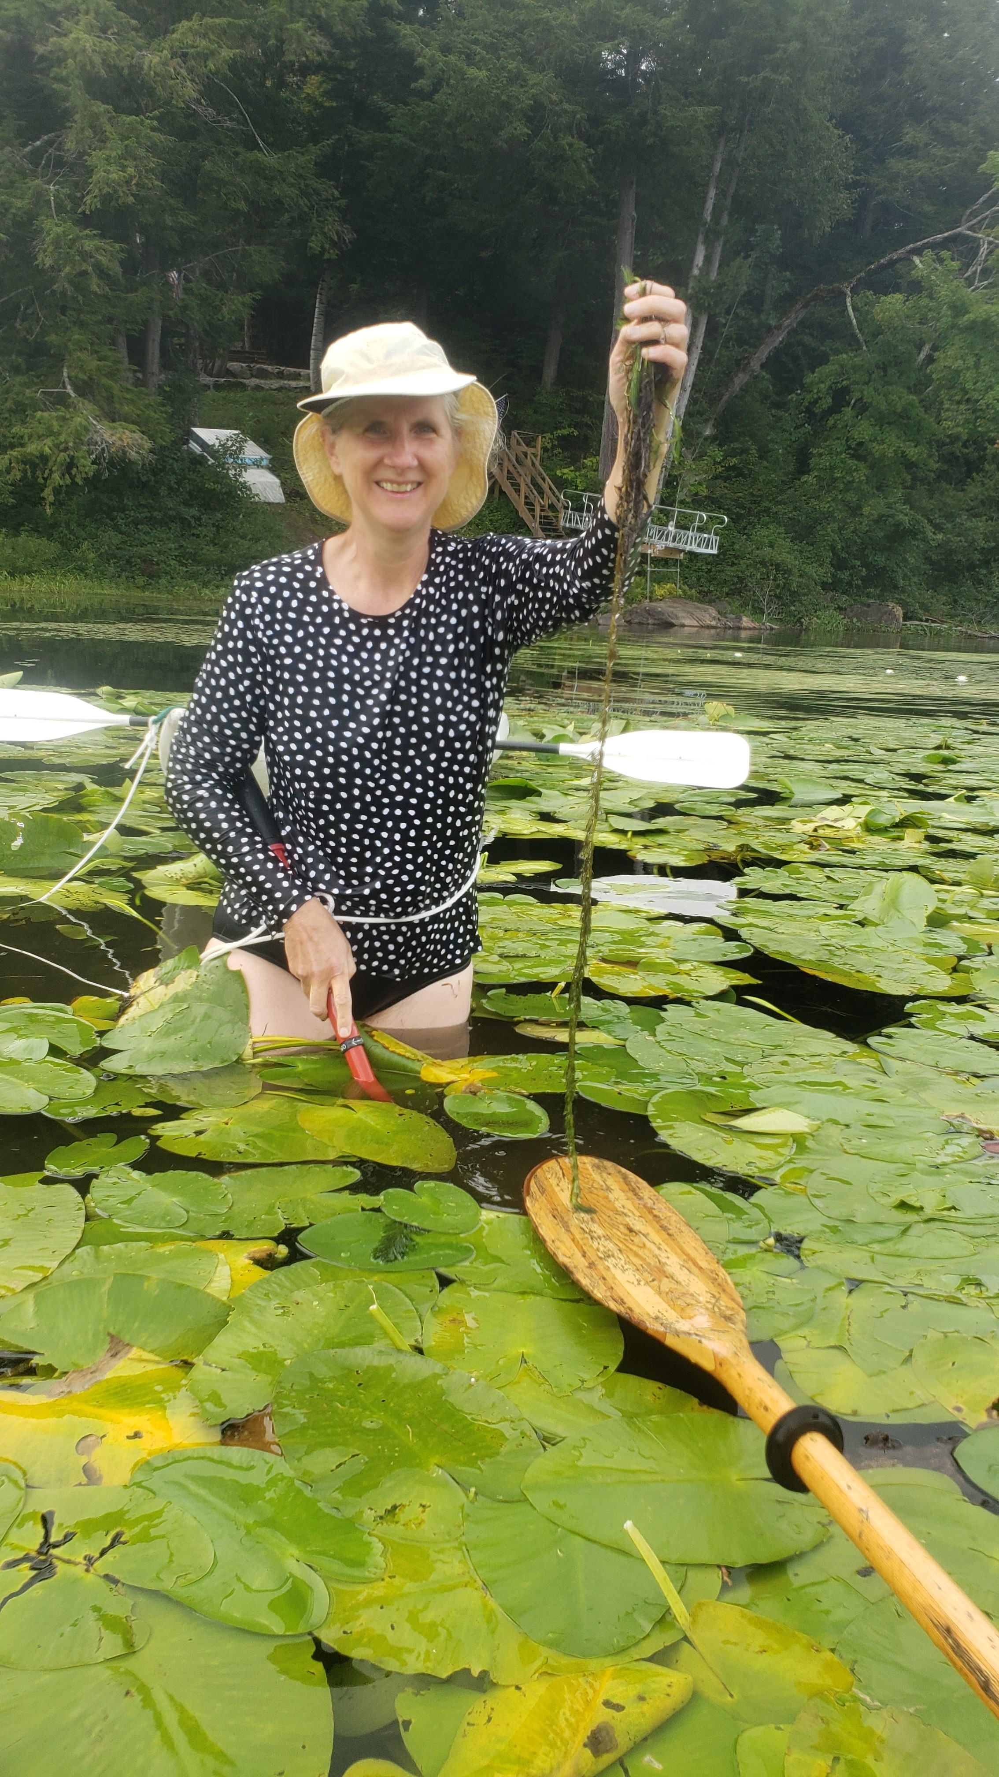
13 Years of Mitigation Efforts by the PLA
Volunteers have been critical to the success of our efforts to control the invasives
Volunteers to scout, dive and snorkel
last year approximately 400+ hours
Conducted on-going training on how to identify
and remove plants
Organized sweeps to mark and harvest
Plants on upper and lower lake
Contracted with AquaLogic in 2017-2021 to
perform suction and hand harvesting

Slide 12
Qualitative Assessment 2017-2020
Fewer EWM Plants in Narrows and Grass Island
Increase in the number of EWM in the Inlet area
Steady state in most Volunteer harvested sites
Some locations show higher variation- need for continued diligence

Slide 13
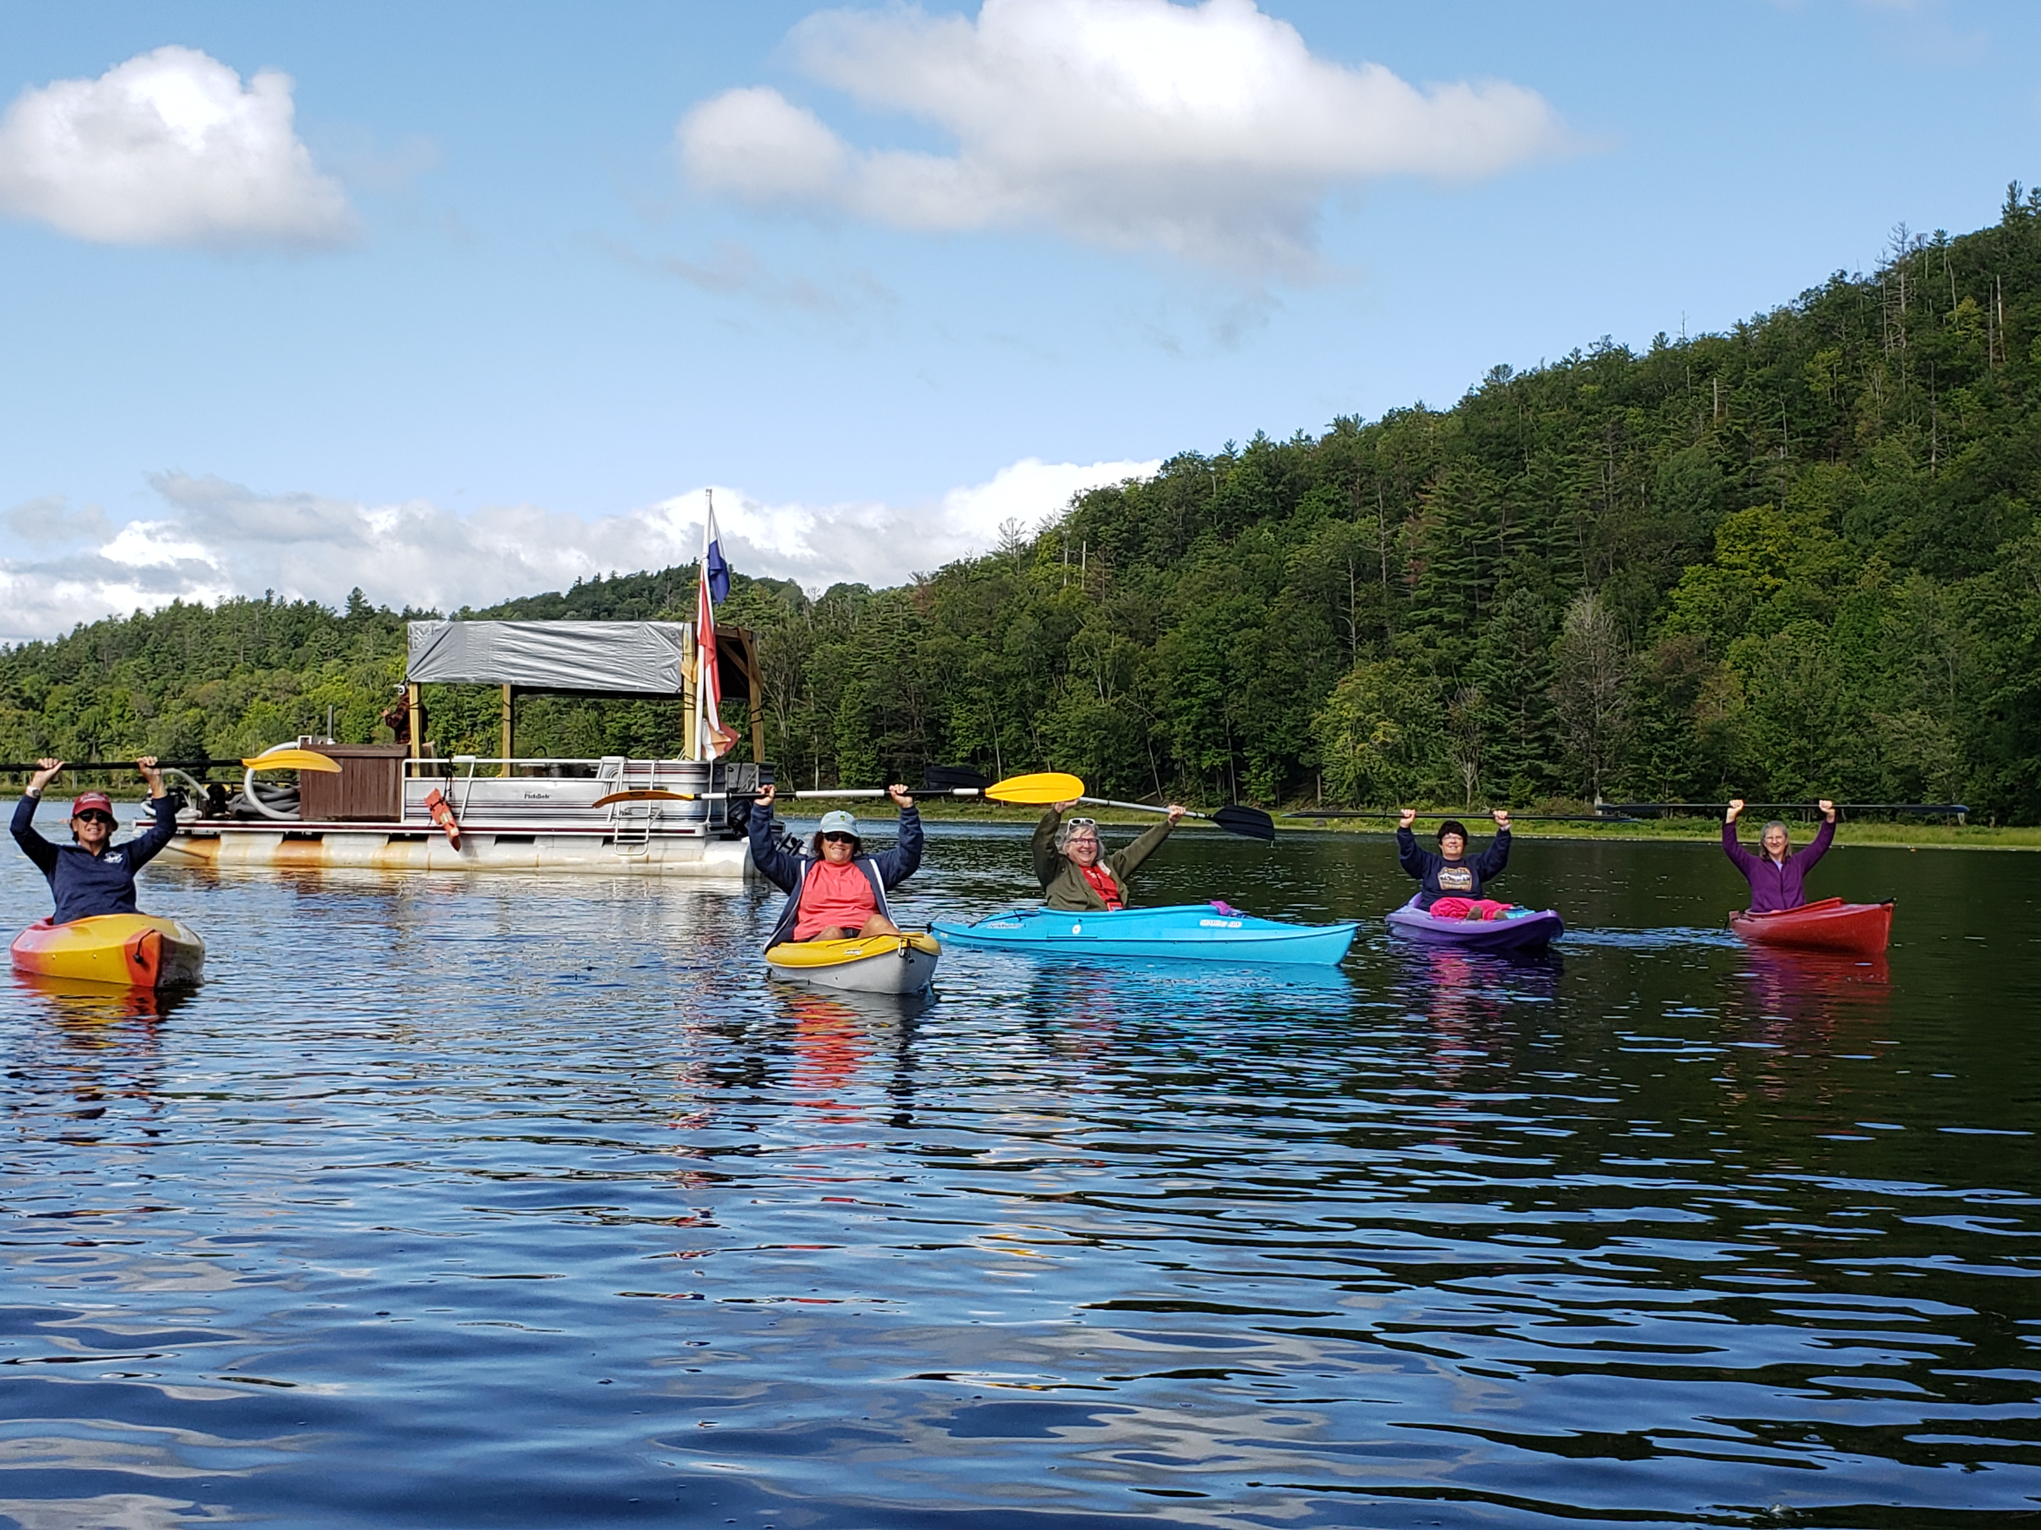
The 2021 Plan
AquaLogic will conduct a lake survey and
conduct 25 days of harvesting (300 dive hours)
funded by PLA and a Grant from AquaLogic
Continue to develop a robust volunteer force
to support our existing group of dedicated
volunteers
Focus on data and track volunteer hours
Create Zone Owners

Slide 14
How can you help?
Volunteer to manage a zone- Lower Lake contact Liz Reid ereid@thelmreidgroup.com
and Gretchen Sunderland for the Upper Lake gretchensun2@gmail.com
Join a sweep and provide surface support for AquaLogic
Attend a training session to learn to identify, mark and safely remove plants
Save Gatorade/vitamin water bottles and make markers
Become a diver- AquaLogic has a dive shop and is offering certification programs in Chestertown www.aqualogicdiveandguide.com
Make a donation to the PLA
If you rent to others please ask them to clean their boat prior to launching and ask them to avoid the markers to prevent fragmentation

Slide 15
Finances
Matt Massiano

Slide 16
Finances
Financial performance in 2020 resulted in $9K surplus

Slide 17
Income by Category
Growth in ’20 income due to increased member donations and NYS grant

Slide 18
Expenses by Category
Additional income applied to increased milfoil harvesting 35% in ’20; further increase planned for ‘21

Slide 19
Finances Focus for 2021-22
Actively involved Finance Committee – Pete Pelone, Doug Kaufman, Matt Massiano
Exploration of funding opportunities with the State, County and Town
Newly-formed Grants Committee, to interact with ESSLA & SLA on joint opportunities and search for other sources. Volunteer opportunity to assist Susan Brown.
Bob Hauserman actively participating with the Schroon Watershed Steering Committee
Continue seeking ways to contain expenses
Continue increasing the number of lake association members and related donations through routine communication and on-the-lake education programs
Continue with fund-raising programs – raffle, calendar/note card sales – plus Schroon Lake Craft Fair

Slide 20
Membership
Dan Gorke

Slide 21
Membership May is Membership Month
How important are donations?
Members’ donations are our #1 source of revenue followed by fundraising events
What does participation look like?
~319 Potential Members
192 paid memberships in 2020, up from 128 in 2019!
74 paid memberships so far in 2021, $11k vs full year budget $24k.

Slide 22
Membership May is Membership Month
How Can You Help?
Be an ambassador. Talk with your neighbors about our cause and the negative impacts of not taking action (property values, impact on recreational activities including boating and fishing)
Tell us. 2020/2021 were busy real estate years. Maybe you have a new neighbor. Go to PLA website and click “Contact Us”, give us some contact information.
Donate what you can at the PLA website (www.paradox-lake.com) where you can pay by credit card and print your receipt. Or send a check to PLA, PO Box 45, Severance, NY 12872
Minimum donation - $20 for Individual, $35 for Family
Remember, it’s your generous donation that carries the association’s activities

Slide 23
Volunteer Opportunities
Dee Dee Foran

Slide 25
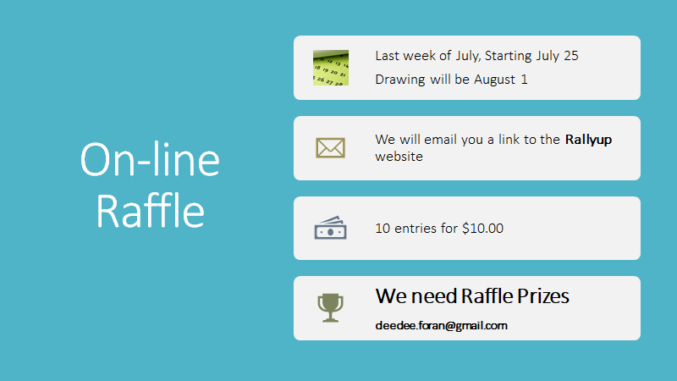

Slide 26
Communications
Micki Kuttler

Slide 27
The communications survey was successful
High level of responses
Good information/insights
Showed current tools are being used

Slide 28
Communication Tool Specifics
Newsletter
Most read in full (>90%)
Good guidance received on what people want to see
Website
Used for a wide variety of activities
News & events/Donations/Educate/Purchase calendars, notecards, etc
Less frequent use by most (76% use a few times a year)
Facebook
Gets limited use (only 21% visit at least monthly)
Could be useful as a replacement for the old chat tool

Slide 29
A Member Directory Appears to be a Popular Idea
Opinions vary on content to include
Name/Local address/Email (85% support)
Cell phone number (only 60% support)
Need to determine how to grant members access without making it public information

Slide 30
Communication Plans for 2021
Newsletter
Improve newsletter to reflect survey input
Welcome articles by guest contributors
Directory
Sort out data security issue
Develop plans for collection of info (Likely publish in early 2022)
Facebook
Determine factors limiting use today
Encourage broader use
Other Communication
Research the need for non-electronic communication with members who are not online
What other avenues should we consider?

Slide 31
2021 Elections – Pete Pelone
To take place at 2021 Annual Meeting (September)
Three positions open
Upper Lake Director, Lower Lake Director, and Vice President, all are three year terms
Interested? Go to www.paradox-lake.com Home page, at bottom click on Contact/Volunteer, Contact Us. Or, speak with another board member.

Slide 32
Summary/Closing Thoughts
We are in good shape…our efforts have paid off
It is critical we stay the course and stay ahead of the spread
Funding is top of mind
Stay Connected (Facebook Group, Email, Website)
Volunteer where you can

Slide 33
Questions?
paradoxlakeassociation@gmail.com

