Slide 1
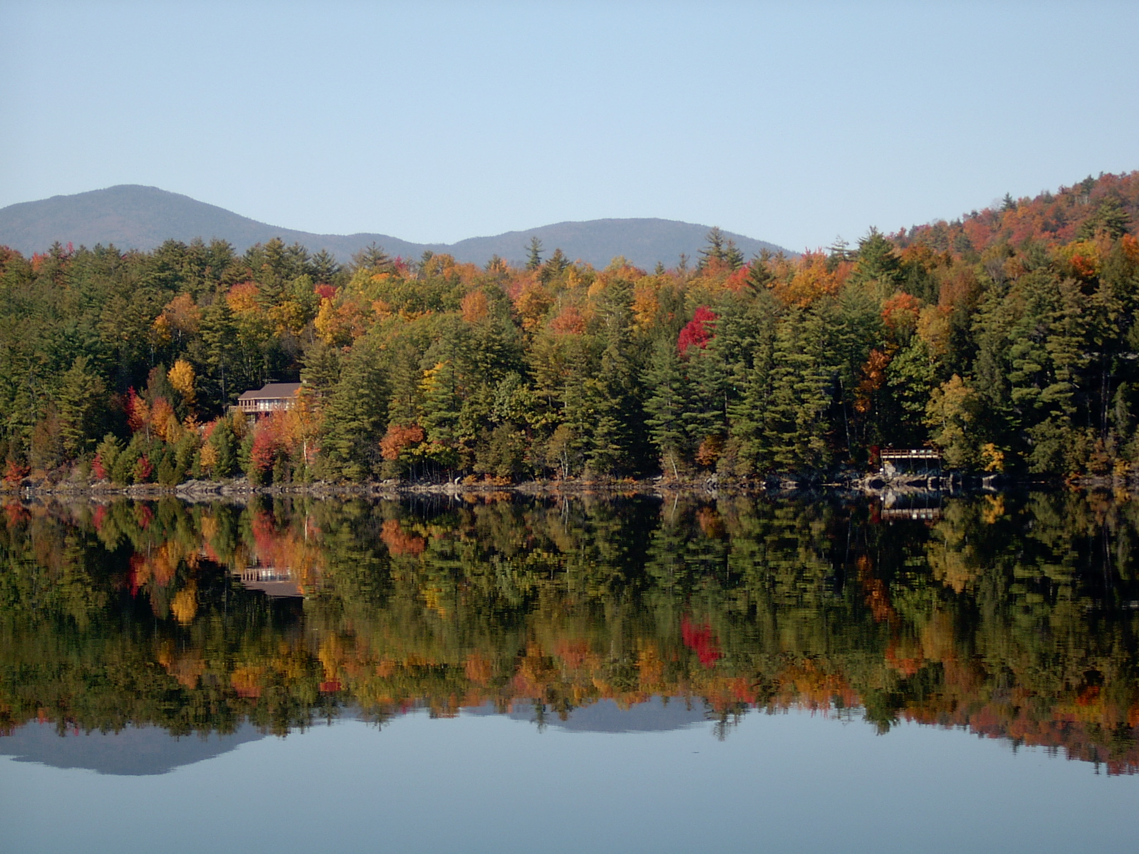
Paradox Lake Association
Annual Business Meeting
September 2021

Slide 2
Welcome from the PLA Board
President – Dan Gorke
Vice President – Vacant
Upper Lake Directors
Nancy Girling, Micki Kuttler, Bob Hauserman
Lower Lake Directors
Pete Pelone, Doug Kaufman, Tony Petrongolo
Treasurer – Matt Massiano
Recording Secretary – Dee Dee Foran

Slide 3
Agenda
Welcome
Nominating Committee
Communications
Invasives Efforts
Finance
Membership
Fundraising
Volunteer Support

Slide 4
Mission Our collective purpose is to preserve and protect Paradox Lake and its surroundings, to enhance the water quality, fishery, boating safety, and aesthetic values of Paradox Lake, as a public recreational facility for today and for future generations.

Slide 5
State of the Lake 2020 – 2021 Objectives
Optimize mitigation efforts used to address aquatic invasives
Increase awareness and engagement of our lake community and visitors by strengthening communications between PLA and our members
Identify funding opportunities to support our purpose
Notes:
Conducted a long range planning exercise
Ensure we have a good picture of where key influencing factors are headed
Increases confidence that the PLA actions are correct and robust
The 2020 Actions are aligned with the PLA objectives
Optimize mitigation efforts used to address aquatic invasives
Increase awareness and engagement of our lake community and visitors
Identify funding opportunities to support our purpose
Identify funding to ensure the long term sustainability of preserving and protecting our lake
Realistic assessment given resource levels and potential Covid 19 impacts

Slide 6
Nominating Committee
Pete Pelone

Slide 7
Board of directors
Officers Directors
President Upper Lake (3)
Vice-President Lower Lake (3)
Treasurer
Recording Secretary
Officers - 3 Year Term
Terms staggered across positions
Directors - 3 Year Term
1 Upper Lake, 1 Lower Lake elected each year

Slide 8
2021 Candidates
Vice-President Bob Hauserman
Lower Lake Director
Scott Randall
Upper Lake Director
Nancy Girling

Slide 9
2022 Elections
President
Treasurer
Recording Secretary
Upper Lake Director
Lower Lake Director

Slide 10
Invasives Efforts
Nancy Girling

Slide 11
It’s been a very busy year!
Highlights
Aqualogic provided a 15k$ grant to PLA
Highest number of Aqualogic dive days
Volunteer activity has increased
Rapid volunteer response to Smith’s Bay milfoil finding
Paradox Lake activities included in Schroon Lake grant application for first time
Overall, holding our ground against milfoil
Challenges
Significant new milfoil findings in the lower lake
AWI Lake Steward program at Paradox Lake had attendance issues
Increasingly difficult to coordinate all contractor and volunteer efforts
Only holding our ground against milfoil

Slide 12
2021data a work in Progress
AquaLogic harvested approximately 50% more EWM plants this year compared to last year, working 40% more hours.
Fragmentation was observed early and continued throughout the season in both basins
Low lake levels early in the season allowed us to see mature plants that were already flowering and may have contributed to fragmentation
AquaLogic will return in early October for their final 5 days of harvesting
Volunteers should report their harvest numbers by location as well as total volunteer hours to girlingnm@gmail.com

Slide 13
Efficiently managing Invasives is critical to our mission
PLA invasives activities are expanding in scope and complexity
More milfoil locations in the lake
Expanded volunteer pool and volunteer activities
Additional external relationships
Enhanced analysis, reporting, and communications
Invasives will continue to be an issue and PLA needs to be efficient and effective
PLA Board Invasives Committee being expanded from 1 to 3 members
Structure, members, activities, responsibilities to be defined by 1Q22 for 2022 season

Slide 14
Finances
Matt Massiano

Slide 15
2021 Financials
On track for a successful year
Year-to-date Income and Expenses at $47,004 and $35,424, respectively
Bank Balance at $65,579… ~$8600 above this time last year
Year-end Income expected to exceed budget by ~ $19,000 with upcoming calendar sales
Member Contributions on plan
Raffle exceeded plan by $2100
Unplanned Aqualogic grant of $15,000
Expenses tracking plan
Additional $21,000 in milfoil harvesting expenses largely offset by Aqualogic grant

Slide 16
Finances

Slide 17
Income by Category

Slide 18
Expenses by Category

Slide 19
Membership
Dan Gorke

Slide 20
2021 Membership
2021 YTD: 181 paid members
Year end 2020, 199 members
On target to meet or slightly exceed 2021 budget of $24,000; our largest source of income
Your membership and donation is critical to allowing us to expand our invasives effort
65% paid via www.paradox-lake.com
Thank you for your membership & contribution; please recruit a neighbor
Ideas for increasing membership: www.paradox-lake.com and click on Contact Us

Slide 21
Fundraising
Dee Dee Foran

Slide 22
2021 Raffle
Raised $6,255
Thank you to our Donors & Sponsors
Schroon Lake Marina
Melissa & Jami Lambert
LuAnn Richardso, Jean Maxwell, Nancy Girling
Linda Marshall
Andrew Nicodema
Stewarts
Tops
Paradox Brewery
Pilon Family
David Kuttler
Vanity Hair Salon
Pelone & Beck Families
Linda McClary
Paul & Diane Clarke
Sticks & Stones
Duke Connor

Slide 23
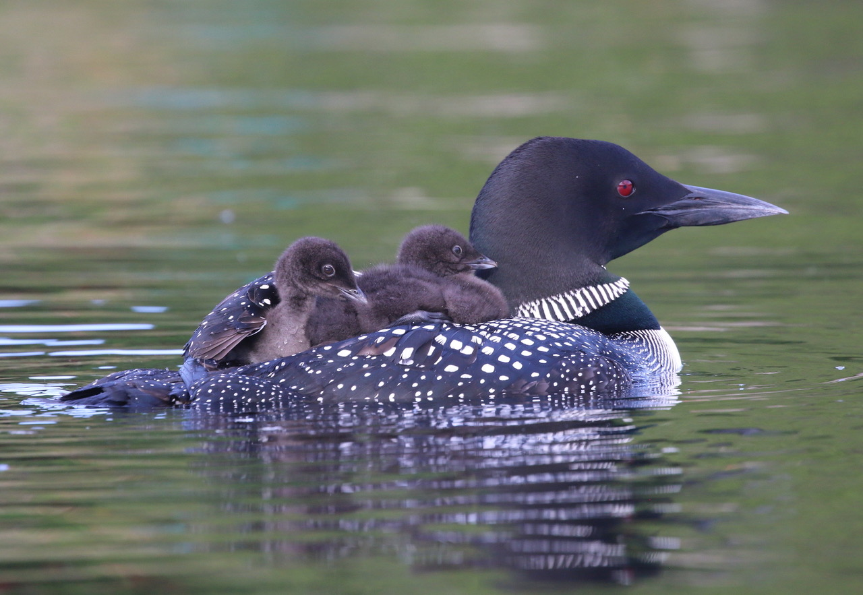
Upcoming fundraisers
2022 Paradox Lake Photo Calendar
Please submit pictures via a Facebook Post
or submit through the PLA Website.
(for each picture, please note the month it was taken,
who to credit for the photo and a brief description)

Slide 24
Communications
Micki Kuttler

Slide 25
Communications to Members
Mailing list has grown from 155 to 300 since September 2019
Newsletters are sent generally once a month and posted on the website under https://paradox-lake.com/news
Board meets monthly; meeting minutes are posted on website once approved under https://paradox-lake.com/meeting-minutes

Slide 26
Communications Between Members and among Community
Private Paradox Lake Association Facebook Group is primary means of communication between members and greater community
Membership has grown to 230 since inception in February of 2020
Membership directory is in planning phase now. Hope to release first version this winter.
If you need assistance in joining or using the Facebook group, please reach out to me at micki@kuttleronline.com

Slide 27
Volunteer Support
Bob Hauserman

Slide 28
Tasks that are done by volunteers
Snorklers Divers Aqualogic support scouts Aqualogic management Rakers Marking invasive plants Craft fair booth Organizing the raffle Calendar Note cards Picnic Membership Writing the newsletter Announcements Grant writing Nominating committee |  | Water testing Making milfoil markers Writing reports Buoy placement & removal Signage at the boat launch Lake survey point data for milfoil monitoring (lake mapping) Conducting training on how to identify and remove invasive plants Coordinating sweeps to remove invasive plants Boat wash & steward tent setup/takedown Merchandise sales Steward recruitment

Slide 29
Thank You to Our Volunteers

Slide 30
2021 Wrap-Up
Water quality: rated AA by DEC
Milfoil: holding our own, perhaps a bit better than a year ago
Strong relationship with Aqualogic
Strengthened our volunteer corps
Financially stable
Improved communications

