Slide 1
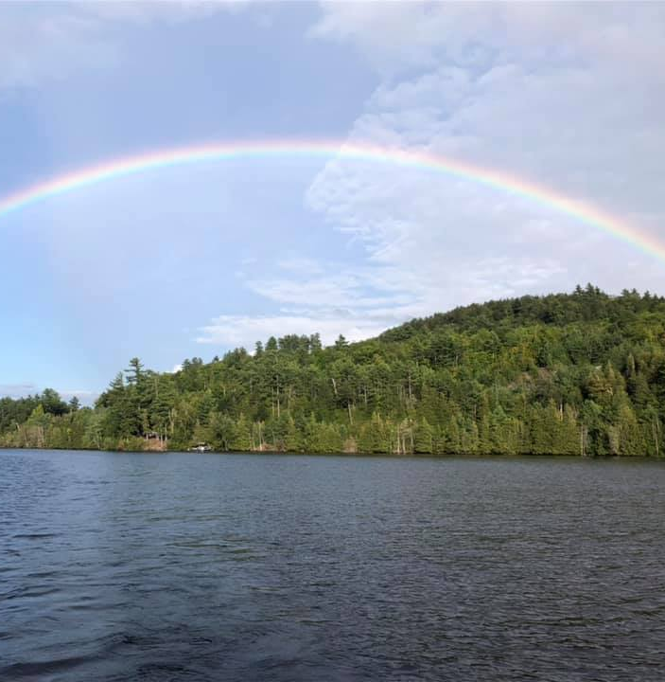
Paradox Lake Association
State of the Lake Meeting
June 25, 2022

Slide 2
Welcome from the PLA Board
President
Dan Gorke
Vice President
Bob Hauserman
Treasurer
Matt Massiano
Secretary
Dee Dee Foran
Upper Lake Directors
Nancy Girling
Micki Kuttler
Jeanette Barth
Lower Lake Directors
Doug Kaufman
Tony Petrongolo
Scott Randall

Slide 3
Agenda
Fund Raising
Water Quality Results
SUNY Oneonta Lake Management Plan Summary
Invasive Efforts
Membership
Finances
Communications
2022 Board Elections
Closing Comments
Brian Greene, APIPP

Slide 4
Invasives Efforts
Bob Hauserman

Slide 5
Eurasian Water Milfoil (EWM) Still A Problem
We have been chasing EWM since 2008
Unfortunately, we have not been making progress in reducing the amount of EWM in the lake despite high levels of volunteer and contractor work:
EWM slowly spreading to new locations
Little sustainable improvement in high density areas
The PLA Board thanks you for your financial support and volunteer activities!

Slide 6
PLA Is Making A Change To Our EWM Management Approach
We are going to implement a surge in activities to reset the EWM population
Three key elements of the surge
Double the # of contract hand harvesting hours (relative to 2021) in 2022, 2023, and maybe 2024
Intensify the management of all scouting and harvesting work to maximize the effectiveness
Treat the 4-6 areas of the lake that have not responded to hand harvesting with an herbicide (ProcellaCOR) in June 2023
Significantly higher costs in 2022-2024 but a reduction in 2025 and beyond (relative to 2021)

Slide 7
Intensive Data Gathering & Analysis Has Been Helpful
Compiled our contract and volunteer harvest info from 2017-2021 across 48 shoreline sectors
Clarified patterns versus anecdotal info
Confirmed slow expansion
Compiled all knowledge held regarding nature of lake and growth by sector
Shoreline and bottom composition/native vegetation/historical growth/wind & current patterns
Several key learnings
EWM spread is primarily driven by wind generated currents
Many sectors do not generate fragments that spread elsewhere in the lake
Need to improve our understanding of the lower lake
Instrumental in developing our plans for 2022 – 2024
We have a detailed plan for 2022 outlining actions required for every lakeshore sector

Slide 8
Key 2022 Plan Actions
Invasives committee to meet every 2 weeks to assess progress and determine work needed during next 2 weeks
Aggressive harvesting as per the sector by sector 2022 plan – Aqualogic on the lake 5 days/week from late
May – August (70 days)
Use of a newly developed app to record/communicate scouting and harvesting information
Identification of all areas that are difficult to successfully hand harvest
Complete work to understand all lower lake sectors
Progress ProcellaCOR application permit process for 2023 application – Includes Plant Survey
Frequent communication with PLA membership and Town of Schroon

Slide 9
Intensity Of Activity Planned For 2022
= No harvesting
= Limited harvesting
= Moderate activity
= Intense activity

Slide 10
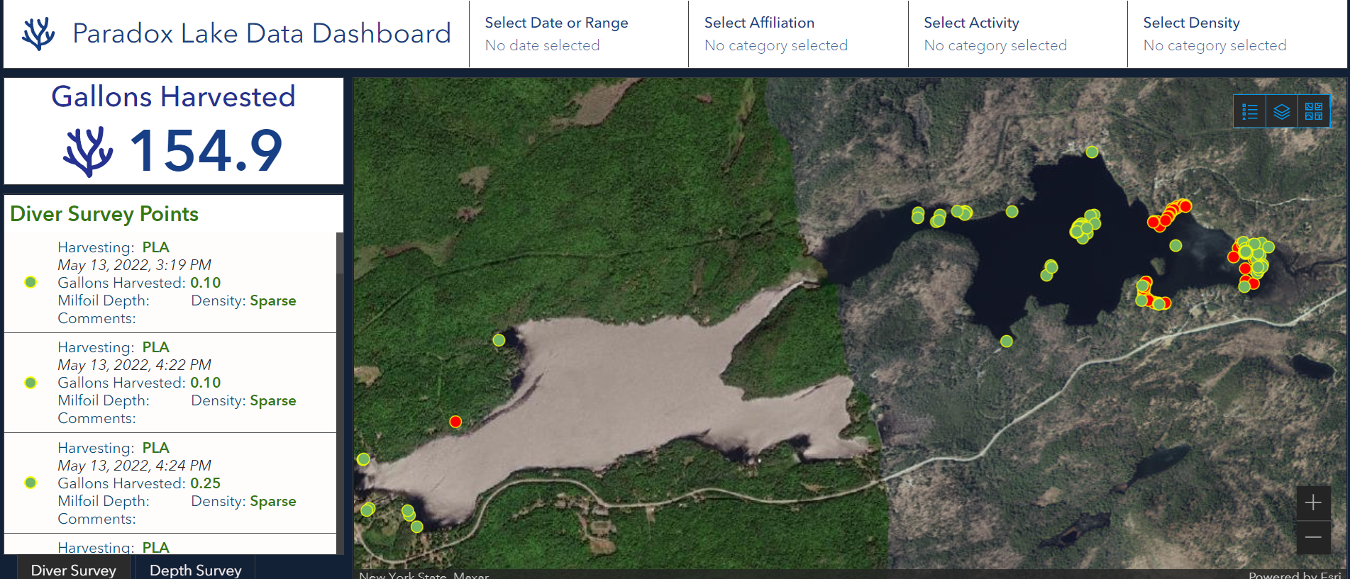
Our New App Allows Real Time Tracking Of Scouting And Harvesting

Slide 11
APIPP Presentation
Brian Greene

Slide 12
Lake Management
Tony Petrongolo

Slide 13
Lake Management Plan
Purpose
Stakeholder Surveys
Fisheries
Water Quality Excellent
Recommendations
Full report will be available soon on our website under navigation bar heading “Protect”

Slide 14
Water Quality

Slide 15
Finances
Matt Massiano

Slide 16
Finances
2021 Actuals: income growth offset added harvesting
2022 Plan: expenses to exceed income by $30,000
2022 Plan: will reduce year-end
bank balance to $38,000

Slide 17
Income by Category
2021 Actuals: income growth due to grants (NYS, Aqualogic, Town) and fundraisers (raffle, calendars)
2022 Plan: added income from picnic
paddle race and raffle events –
does not reflect membership goal of $34,500!

Slide 18
Expenses by Category
2021 Actuals: doubling in milfoil harvesting expenses 2022 Plan: additional 60% harvesting plus herbicide survey/permitting

Slide 19
3-Year Budget Outlook
Seeking 3 years of increased member contributions to meet EWM demands!
Budget assumes member contributions and grants remain flat
Forecast ~ $100K total shortfall over ‘22-’24 period without additional revenue

Slide 20
Finances Focus for 2022-23
Continue increasing the number of members and related donations through frequent communications
Establish goal to increase annual member contributions to $34,500… an increase of 30% per member!
Explore funding opportunities with the State, County and Town
Grants Committee led by Susan Brown continues to search new opportunities
Bob Hauserman participating with the Schroon Watershed Steering Committee
Paradox Lake included in Warren County grant request, as part of Schroon Lake Watershed
Participation in Town of Schroon September Budget Workshop to request increased funding for ‘23
Continue traditional fund-raising programs
Actively involved Finance Committee – Jeanette Barth, Doug Kaufman, Matt Massiano

Slide 21
Membership
Dan Gorke

Slide 22
Membership May was Membership Month
Full year 2021 $26,500
YTD 2022 $30,580
2022 Goal $34,500
Full year 2021 206 paid members
YTD 2022
143 paid members

Slide 23
Membership Next Steps …..
Letters to former members & non-members in July
Capital Campaign – we hope not
Recruit a neighbor
Tell us about a potential member at www.paradox-lake.com , click on CONTACT
If you haven’t already donated yourself, www.paradox-lake.com , or mail to PO Box 45, Severance, NY 12872

Slide 24
Fund Raising
Dee Dee Foran

Slide 25
Member Picnic
Must purchase ticket in advance $10
August 21
12:00 – 4:00
https://go.rallyup.com/paddle
Catered Food, Live Music, Beer provided by Paradox Brewery, Swimming with Inflatables, Tour of Facilities

Slide 26
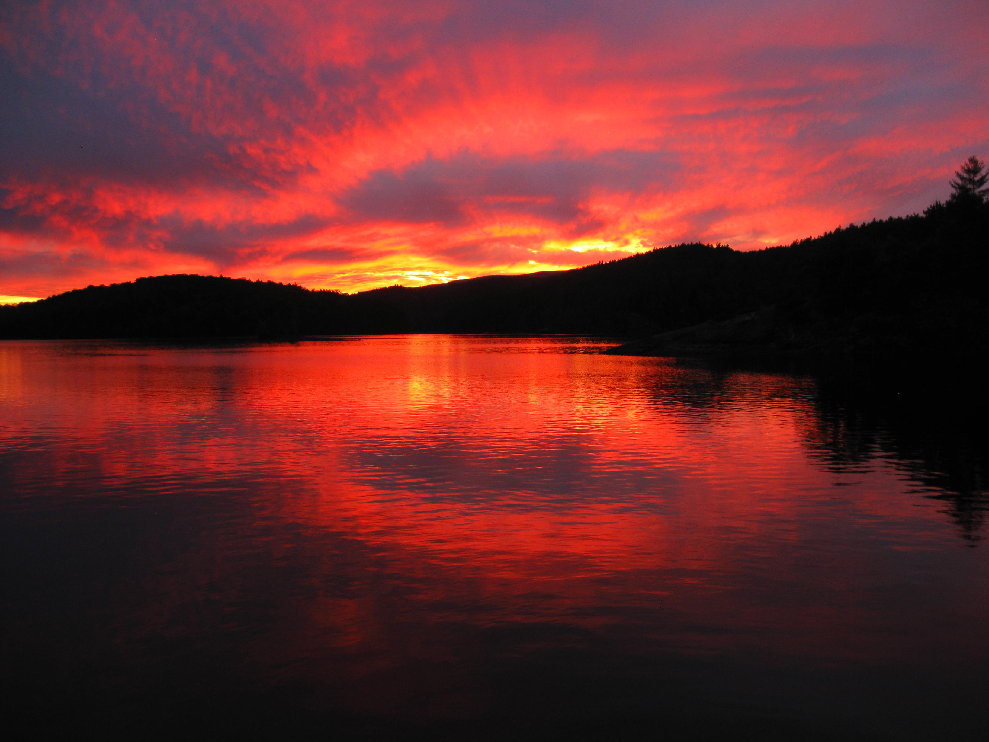
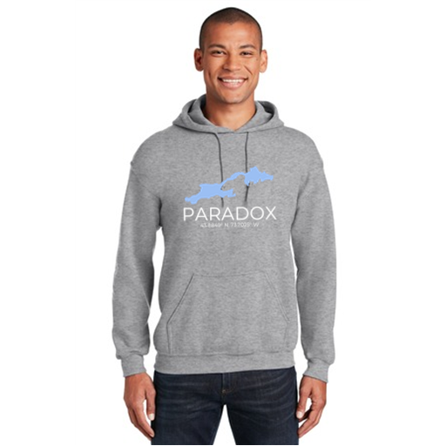
On-Line Raffle July 1 – August 14
10 entries for $10
We will send an email with the link to the website
Facebook Post with featured items
Ryan & Amanda Ragland rnaragland@gmail.com
2023 Calendar Sales (October)
Submit your pictures to Dee Greer yankeedee23@gmail.com
Selling Merchandise & 50/50 Raffle
July 2 @ Paradox Brewery
July 23 @ Schroon Arts & Crafts Tent
Website: https://paradox-lake-association.spiritsale.com

Slide 27
PLA is now an Amazon Smile Charity
AmazonSmile will donate 0.5% of all eligible purchases to PLA when you shop.
Whenever you want to shop at Amazon on your web browser, go to smile.amazon.com, instead of amazon.com to activate your donation setting.
To activate AmazonSmile in the Amazon Shopping app, simply tap on “AmazonSmile” within the Programs & Features menu or Settings and follow the on-screen instructions.

Slide 28
Communications
Micki Kuttler

Slide 29
Forms of Communication
Website paradox-lake.com
3600 unique visitors in the last 12 months, with at least 200 visits per month
Mostly used for Donations, News/Events, Purchasing merchandise, Education
Newsletters
Delivered via Email
Mailing list up 30% in past year.
We welcome and encourage guest contributors.
Facebook
Paradox Lake Association Facebook Group
Membership up 26% in past year
Mostly used for Photo sharing, contractor recommendations, local issues and events, lost and found
Groups.io
Private online chat room for PLA members and friends
Main advantage over Facebook is the potential for a PLA Directory.
309 members

Slide 30
Board Elections
Scott Randall

Slide 31
2022 Board Elections
To take place at 2022 Annual Meeting (September)
Five positions open
Upper Lake Director, Lower Lake Director, President, Secretary, Treasurer (all are 3 year terms)
Interested? Go to www.paradox-lake.com
Home page, at bottom click on Contact/Volunteer,
Contact Us
Or Contact:
Scott Randall randallscottj@gmail.com
Micki Kuttler micki@kuttleronline.com

Slide 32
Summary/Closing Comments
Stay informed
Newsletter
Website
Attend our events, bring your neighbor
Get involved, volunteer
Don’t forget the APA comment period, let them hear from us
Thank you!

Slide 33
Questions?

Slide 34
PLA Evaluated Several Options
There were three future options for EWM mitigation
Reduce efforts and accept greater EWM spread and density
Continue with the current approach – And hope we can maintain the current level of EWM without extraordinary cost increases
Attempt to reset the EWM spread and density (population) with more intensive hand harvesting and use of the herbicide ProcellaCOR

Slide 35
2 Potential Paths Forward – Both Strain The PLA Fundraising Ability
Option 2 likely requires spending above current level for foreseeable future
Option 3 requires a spending spike but promises a return to much lower level of spending
Window of
uncertainty
Actual 2021 spend
was $28750 due to
Aqualogic grant
Projected Future Spend

Slide 36
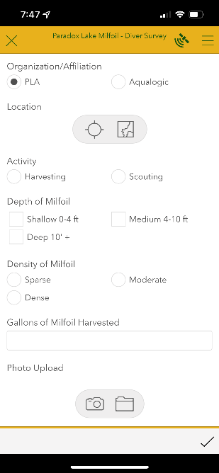
Warren Co. Developed App Is Promising For Data Collection

